Slide 1
CA683 – Group 3
16211668 - Sanjay Singh
16213216 - Kevin Shortall
16213319 - Ken Brennock
16212373 - Javedali Shaikh

Slide 2
Question
Unsupervised Text Categorization

Slide 3


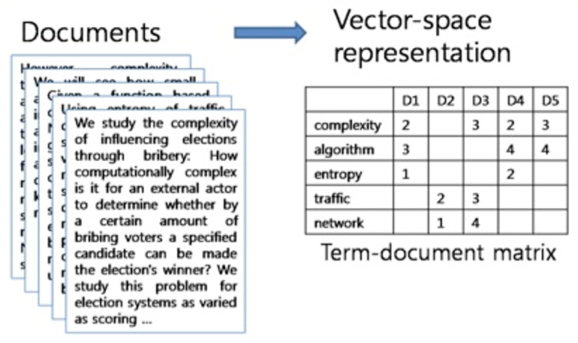



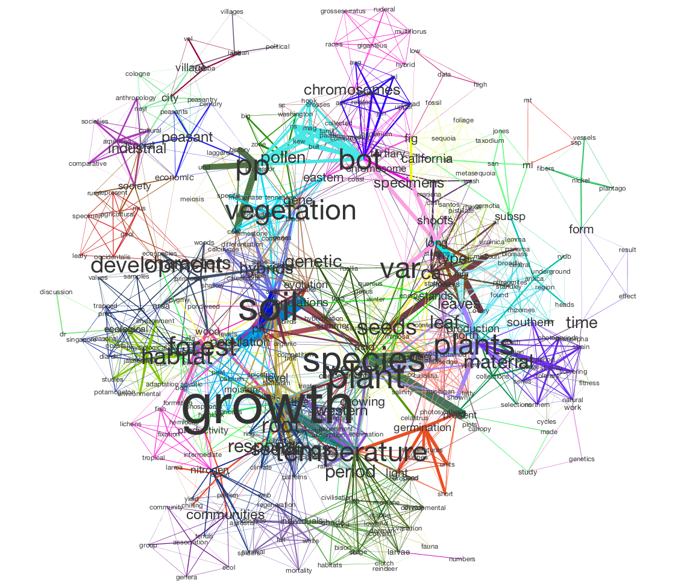
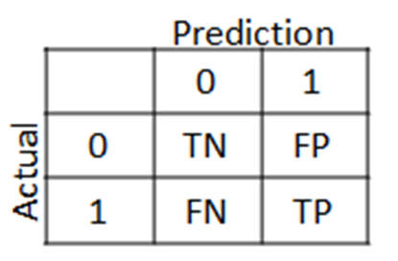

Crisp DM
Data Understanding
DATA
Statistics
Cleaning
Data Preparation
Preprocessing
Feature Extraction
Modelling & Evaluation
Topic Modelling

Slide 4
Data Understanding
18K documents ranging in size from 1K to ~44K.
20 Categories (evenly distributed with ~900 documents each)
Some very similar groups in the sample data - soc.religion.Christian, talk.religion.misc, alt.atheism.
500K unique tokens in original data.
Source: http://qwone.com/~jason/20Newsgroups/

Slide 5
Data Preparation
Removed stop-words (+user-defined), numbers & punctuation
Removed non-English words (found some German words when investigating the files)
Stemming
Removed the unique words (LDA)
Reduced the unique tokens (‘words’) down to 25,174

Slide 6
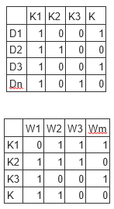
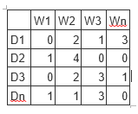
LDA (Latent Dirichlet Allocation)
Topics to Documents
Document Term Matrix
Words to Topics
https://www.analyticsvidhya.com/blog/2016/08/beginners-guide-to-topic-modeling-in-python/
Notes:
Tell the algorithm how many topics
Assign a temporary topic to every word
Algorithm will check and update topics based on the probabilities below;
Probability of the word across a topic – p(topic t / document d) = the proportion of words in document d that are currently assigned to topic t
Probability of the topic is in the document - p(word w / topic t) = the proportion of assignments to topic t over all documents that come from this word w
Documents scored by multiplying these two probabilities
https://algobeans.com/2015/06/21/laymans-explanation-of-topic-modeling-with-lda-2/

Slide 7
Pre-processing & LDA Output
Input:
From: guncer@enuxha.eas.asu.edu (Selim Guncer )Subject: Re: Islam & Dress Code for womenIn article <16BA7103C3.I3150101@dbstu1.rz.tu-bs.de> I3150101@dbstu1.rz.tu-bs.de (Benedikt Rosenau) writes:>In article <1993Apr5.091258.11830@monu6.cc.monash.edu.au>>darice@yoyo.cc.monash.edu.au (Fred Rice) writes:> >>(2) Do women have souls in Islam?>>>>People have said here that some Muslims say that women do not have>>souls. I must admit I have never heard of such a view being held by>>Muslims of any era. I have heard of some Christians of some eras>>holding this viewpoint, but not Muslims. Are you sure you might not be>>confusing Christian history with Islamic history?>>> >Yes, it is supposed to have been a predominant view in the Turkish>Caliphate.> I am not aware of any "Turkish Caliphate" viewpoint on this. Can youreference?However, I found a quote due to Imam Ali, whom the Shias follow:"Men, never obey your women in any way whatsoever. Never let them give theiradvice on any matter whatsoever, even those of everyday life. Indeed, allowthem freely to give advice on anything and they will fritter away one'swealth and disobey the wishes of the owner of this wealth. We see them without religion, when, alone, they are left to their owndevices; they are lacking in both pity and virtue when their carnaldesires are at stake. It is easy to enjoy them, but they cause greatanxiety. The most virtious among them are libertines. But the mostcorrupt are whores. Only those of them whom age has deprived of anycharm are untainted by vice. They have three qualities particular tomiscreants; they complain of being oppressed, whereas it is theywho oppress; they make oaths, whereas they are lying; they pretendto refuse men's solicitations, whereas they desire them most ardently.Let us beg the help of God to emerge victorious from their evil deeds.And preserve us in any case from their good ones."(Quote from Mas'ud al-Qanawi, ref. A. Bouhdiba, Sexuality in Islam, p. 118).I wouldn't consider this quote as being exemplary of the Islamic (TM)viewpoint though. For all we know, the prophet's cousin andthe Fourth Khalif Hazret-i Ali may have said this after a frustrating night with a woman.Selim Guncer--Selim E. Guncer | Jaca negra, luna grande,CSSER-ASU | y aceitunas en mi alforja.(602)-965-4096 | Aunque sepa los caminosguncer@enuxha.eas.asu.edu | yo nunca llegare a Cordoba.. (FGL)
Pre-Processing Output:
islam dress code woman article in article rice woman soul islam people said muslim say woman soul must admit never heard view held muslim era heard christian era holding viewpoint muslim sure might confusing christian history islamic history yes supposed predominant view turkish caliphate aware turkish caliphate viewpoint reference however found quote due imam ali shia follow men never obey woman way whatsoever never let give advice matter whatsoever even everyday life indeed allow freely give advice fritter away wealth disobey wish owner wealth see religion alone left device lacking pity virtue carnal desire stake easy enjoy cause great anxiety libertine corrupt whore age deprived charm untainted vice three quality particular miscreant complain oppressed oppress make oath lying pretend refuse men solicitation desire ardently let beg help god emerge victorious evil deed preserve case good quote ref sexuality islam consider quote exemplary islamic tm viewpoint though know prophet cousin fourth khalif ali may said frustrating night woman luna en mi cordoba
LDA Output:
Politics.Middleast:
Muslim, Turkish, year, world, turk, million, earth, history, nazi, genocide

Slide 8
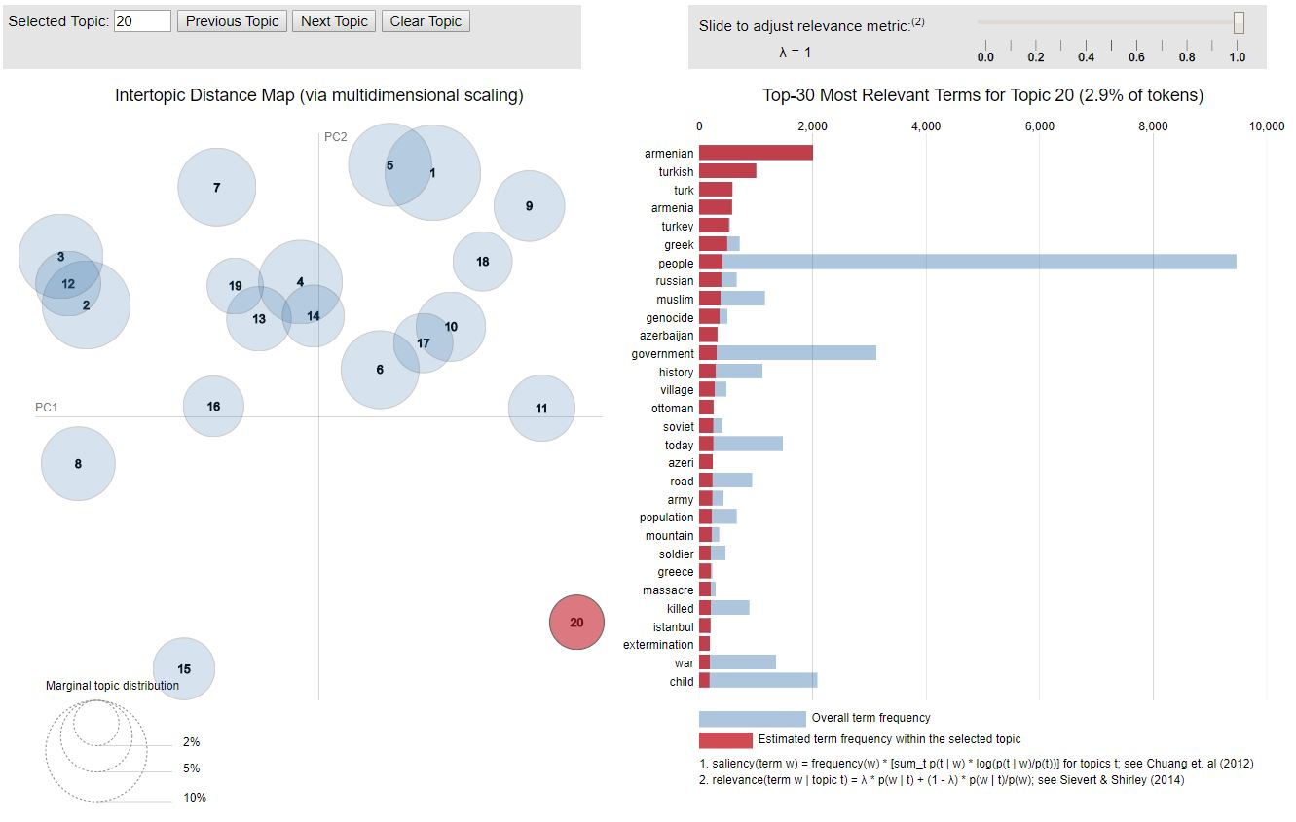
Visualising LDA (using LDAvis package in R)
λ = Relevance to the selected topic.
Distance between topics = an approximation of the relationship between the topics.
Red bar = term frequency within selected topic.
Blue bar = overall term frequency across the corpus of documents.
Circle size is proportional to the topic frequency.

Slide 9
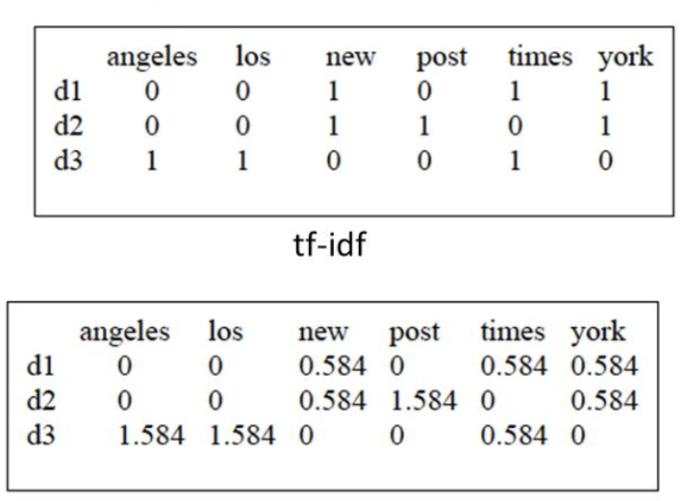
NMF – Feature Extraction
Bag of words
TF-IDF

Slide 10
NMF (Non-negative Matrix Factorisation)
A = W * H
Ref : Non Matrix Factorisation, by Mark Belford et al , UCD, Dublin NLP meetup, 19th March 2018
Notes:
Two factors, W and H are generated which approximate A. Each has k dimensions. We can interpret the
results as k topics, with their associated terms and assignments for documents.

Slide 11
NMF – Output
Input:
The classic comment on new encryption algorithms comes from\nFriedman:\n\n\t"No new cypher is worth considering unless it comes \n\tfrom someone who has already broken a very hard one."\n\nHistorically, Friedman has been right. It\'s really hard to develop\na good cypher. IBM\'s Lucifer, the precursor to DES, turns out to have\nbeen fatally flawed. Most of the DES-like systems other than DES seem\nto be vulnerable to differential cryptanalysis. The first two tries at\npublic key encryption (remember knapsack cyphers?) were broken. Most\nif not all of the machine cyphers of the electromechanical era were\nbroken eventually. Attempts in the computer era to home-brew encryption\nhave been disappointing; the classic "A survey of data insecurity packages"\nin Cryptologia contains analyses and breaking techniques for a few of the\npopular "security packages" of the late 1980s.\n\
Output:
SCI-Crypt: key chip encryption clipper keys escrow government algorithm phone use nsa security secure des public encrypted number law privacy enforcement

Slide 12
Evaluation
Two Measures:
Confusion Matrix
Stability
Confusion Matrix Process:
Manually labelled all topics from LDA/NMF (really hard!)

Slide 13
Evaluation – Precision - NMF
Overall: 30%
Good Labels
Crypt: 80%
Politics Middle-east: 68%
Confused Labels (due to close relation)
Mac Hardware: 26%
IBM Hardware: 42%
Missed Labels
Religion Atheism
Medical

Slide 14
Evaluation – Precision - LDA
Overall: 32%
Good Labels
Windows.X: 89%
Hockey: 86%
Politics.middle-east: 80%
Confused Labels (due to close relation)
Graphics (18%)
Mac.Hardware (17%)
Missed Labels
Religion Atheism
Medical

Slide 15
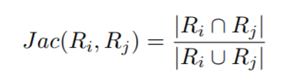
Evaluation - Stability
Average Term Stability – compares the similarity between two topic models based on a pairwise matching process at the topic level.
Jaccard Index:
Stability of topic modelling, by Mark Belford et al., Dec 2017 - https://arxiv.org/pdf/1702.07186.pdf
Reference Code - https://github.com/derekgreene/topic-ensemble

Slide 16
Evaluation – Stability - NMF
Stability was measured with 20 topics and various combination of top terms (10, 20, 30, 40, 50)
Stability increased as we increased the number of top terms per topic.
Graph

Slide 17
Conclusion
Both models faced difficulties in identifying topics which are closely related (autos-bikes).
Varying sizes of documents impact the performance.
More data would be required to improved the performance of models.
NMF runs much faster than LDA!
Quality of words were better in LDA.
Doing text classification is really hard with unsupervised algorithms!

Slide 18
Questions

